Slide 1
VLSI DESIGN FLOW
V.SRAVANTHI
CHIPWEAVE TECHNOLOGIES PVT LTD

Slide 2
CONTENTS
Introduction
Design Specification
Design Entry
Functional Simulation
Placing and routing
Timing Simulation
Fabrication

Slide 3
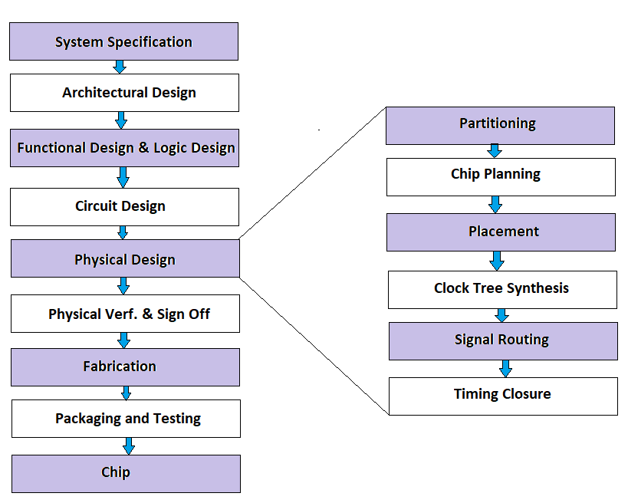
VLSI DESIGN FLOW

Slide 4
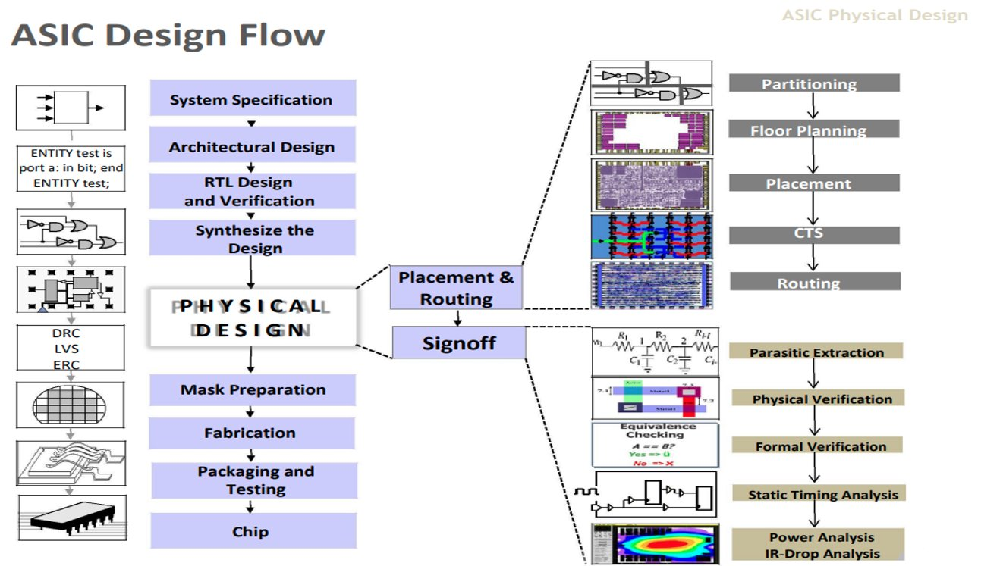
VLSI DESIGN FLOW(Contd..)

Slide 5
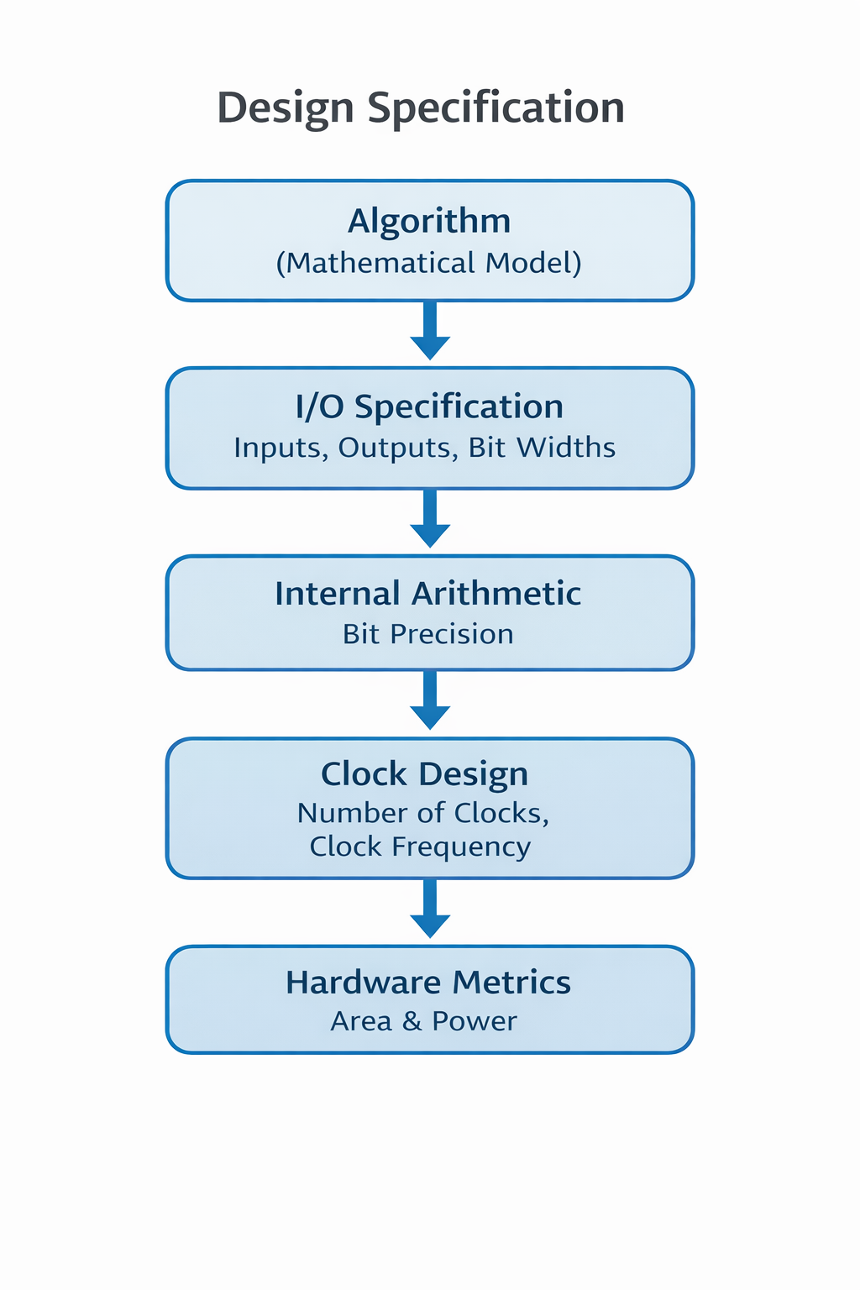
Design Specification
The number of inputs and outputs in the design, along with the number of bits allocated for each signal.
The number of bits used in internal arithmetic operations within the design.
The number of clock signals required for the design implementation.
The maximum clock frequency supported by the design.
The estimated area of the chip required for implementation.
The expected power dissipation of the chip.

Slide 6
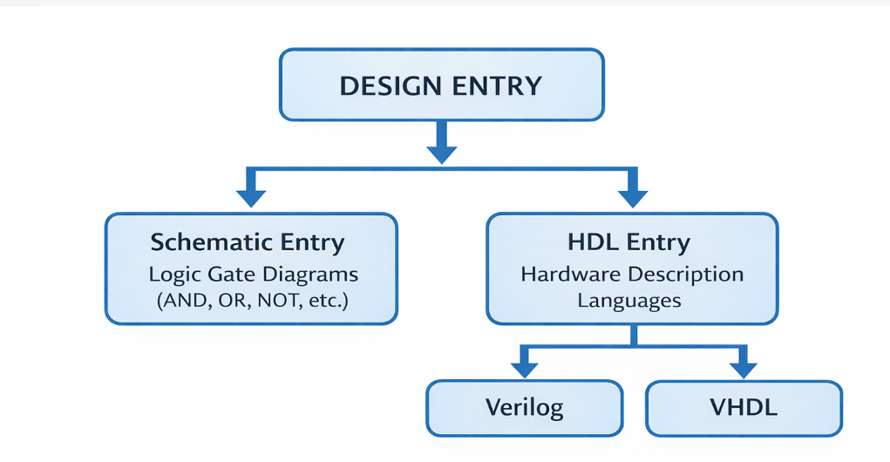
Design Entry
Design entry is the process of describing a digital system either through schematic diagrams or hardware description languages such as Verilog and VHDL.

Slide 7
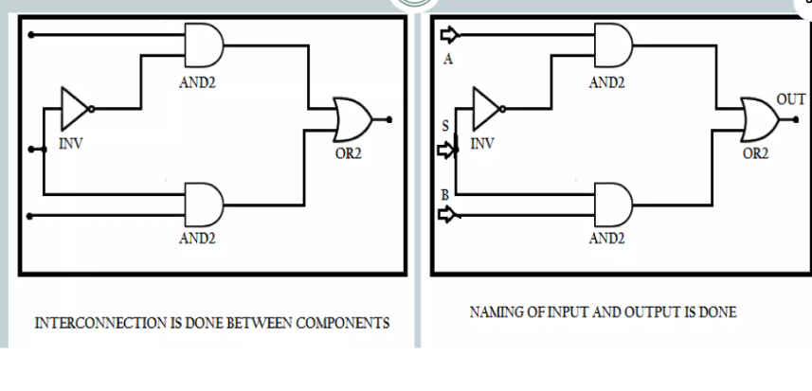
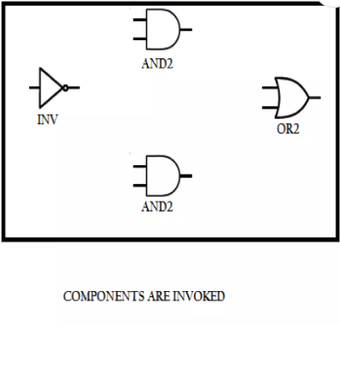
Design Entry(Contd..)

Slide 8
Functional Simulation
Functional simulation is performed before design implementation to verify that the logic created is correct.
It helps ensure that the design functionality works as intended according to the design specifications.
Schematic Flow: Functional simulation is carried out immediately after completing the design using schematic entry tools.
HDL Flow: Functional simulation is performed after the design is written using HDL (Verilog/VHDL) and before or during synthesis.
ModelSim / QuestaSim​
VCS (Synopsys)​
Xcelium (Cadence)​
Verilator (open source)

Slide 9
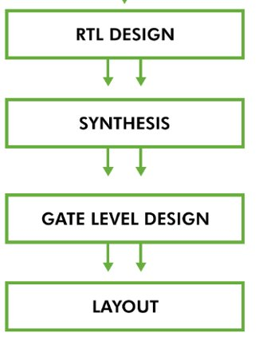
Synthesis(Logic Synthesis)
Synthesis is the process of converting RTL code(Verilog/SystemVerilog/VHDL) into a gate-level netlist using standard cells from a technology library.
RTL: assign y = a & b;​
1. RTL describes behavior​
2. Synthesis identifies AND operation​
3. Library cell AND2_X1 selected​
4. Netlist generated: AND2_X1 U1 (.A(a), .B(b), .Z(y));​
​

Slide 10
Planning Placement and Routing
PPR is a VLSI physical design or layout phase where the logical design is converted into a physical layout on the chip.
It is an automated design process performed using Computer-Aided Design (CAD) tools.
The main objective is to optimize area, performance, and power consumption of the chip.
Various Phases in PPR
Partitioning – Dividing the design into smaller functional blocks.
Floor Planning – Determining the approximate placement of major blocks on the chip.
Placement – Positioning standard cells and modules within the chip area.
Routing – Creating electrical connections between placed components.

Slide 11
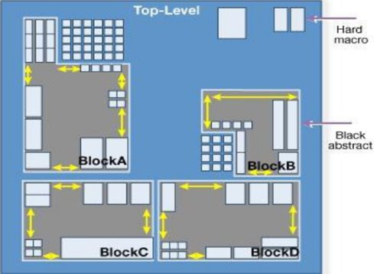
Planning Placement and Routing(Contd..)
Partitioning
Partitioning is the process of dividing a circuit into smaller sub-circuits. • Each sub-circuit should have an area within the prescribed range. • The number of interconnections between sub-circuits is minimized to improve performance and reduce complexity.

Slide 12
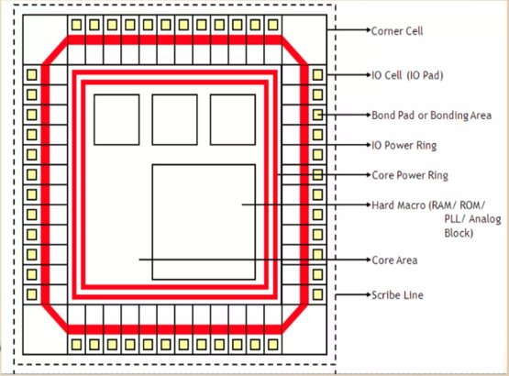
Planning Placement and Routing(Contd..)
Floor Planning
Floor planning determines the shape and size of each sub-circuit module.
It also defines the pin locations at the module boundaries.

Slide 13
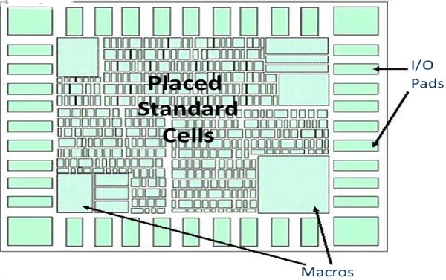
Planning Placement and Routing(Contd..)
Placement
Placement determines the best position for each module on the chip.
Each module has a fixed shape, area, and terminals.

Slide 14
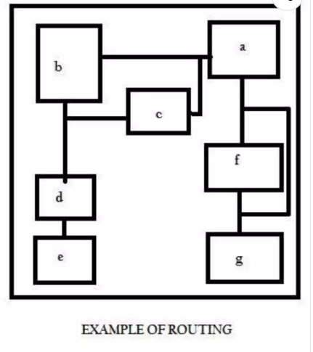
Planning Placement and Routing(Contd..)
Routing
Routing is the process of connecting different circuit components using wires.
The objective is to minimize chip area and total wire length.
Types of Routing:
Global Routing
Channel Routing

Slide 15
Timing simulation
Timing simulation in VLSI is used to verify the functionality of a digital circuit by considering the actual propagation delays of gates and interconnections.
These delays affect how signals travel through the circuit and determine whether the design operates correctly at the desired clock frequency.
Timing simulation mainly includes two types of delays:
1)Gate Delay : Delay from gate input to gate output.
2)Net Delay : Delay from output of one gate to input of another gate through wires.
Ensures the circuit works correctly at the required clock speed

Slide 16
Fusing / Fabrication into Chip
Final step of VLSI design where the layout is converted into a physical semiconductor chip
VLSI Design
│
▼
Fabrication (Chip Manufacturing)
│
▼
Design Styles
│
┌──────────────────────────┐
▼ ▼
Full Custom Semi Custom
│
┌───────────────┐
▼ ▼
Cell Based Array Based
Design Design

Slide 17
Fusing / Fabrication into Chip(Contd..)
Full Custom Design
ASIC designed specifically for a particular application.
Semi-Custom Design
Uses predefined libraries or prefabricated structures.
• Cell Based Design – Uses standard cells from libraries. • Array Based Design – Uses prefabricated matrices (like FPGA).

Slide 18


